Slide 1

Full Stack App with AWS Amplify & figma
Sanjay Patel
ptsn@amazon.com

Slide 2
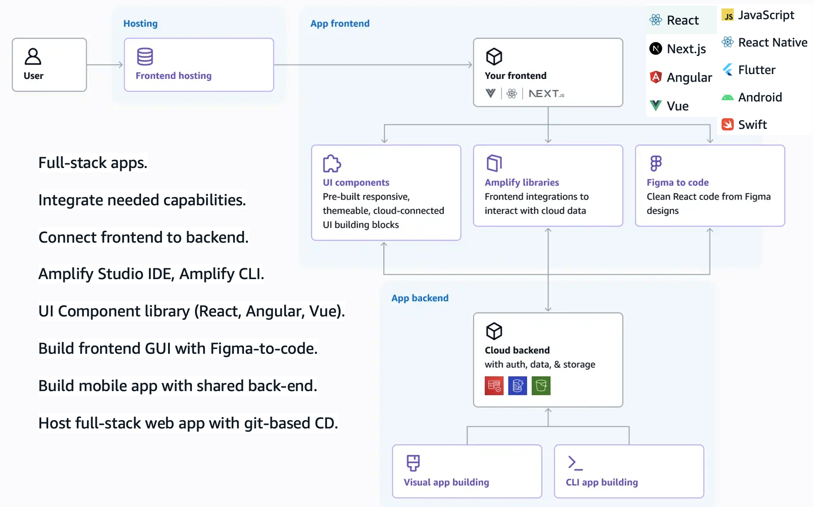

AWS Amplify

Slide 3
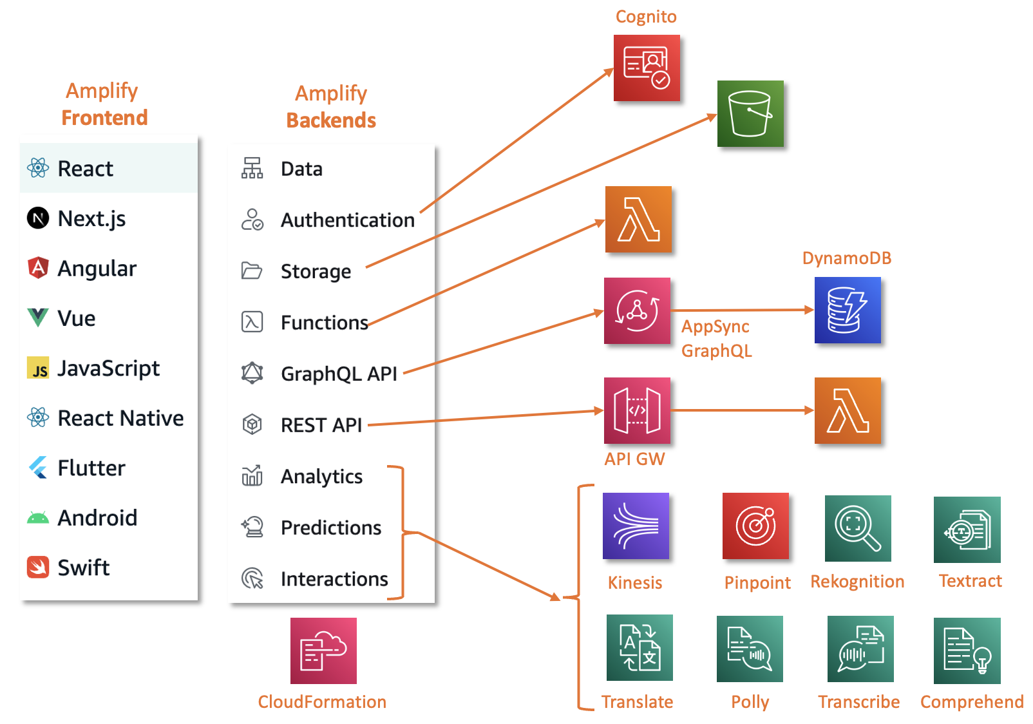
AWS Amplify Frontend & backend

Slide 4
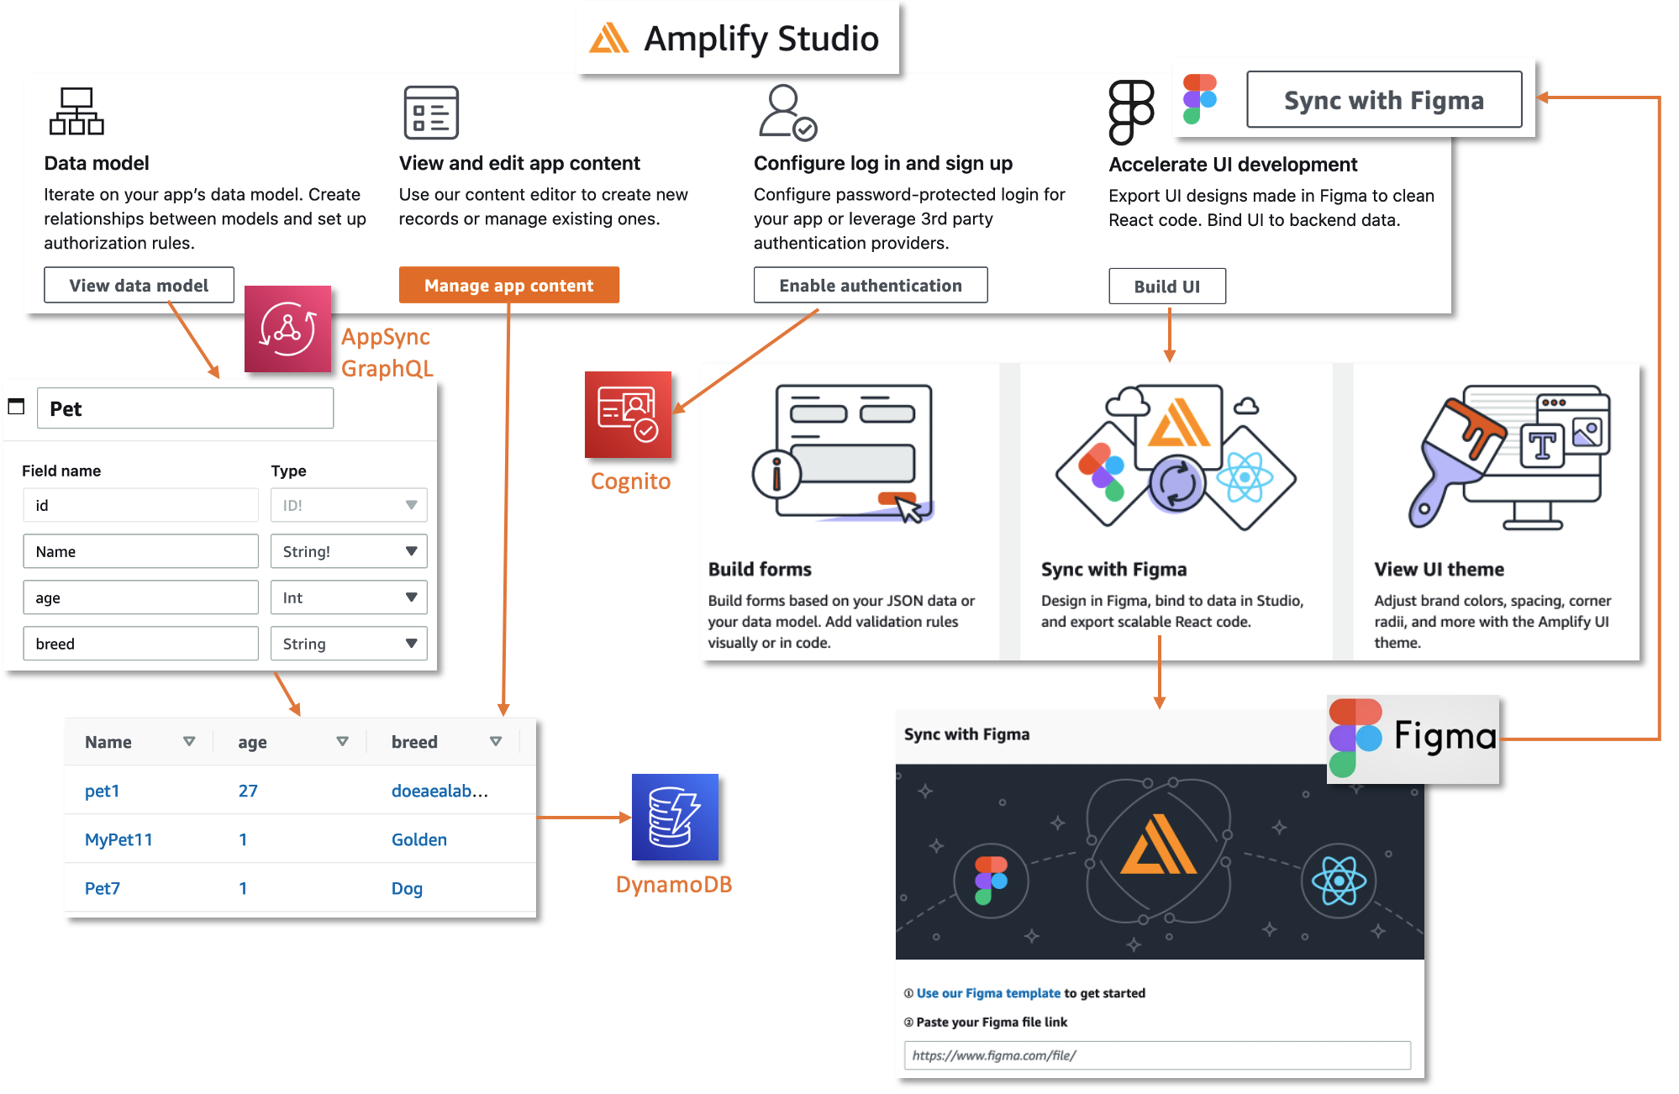
AWS Amplify studio

Slide 5
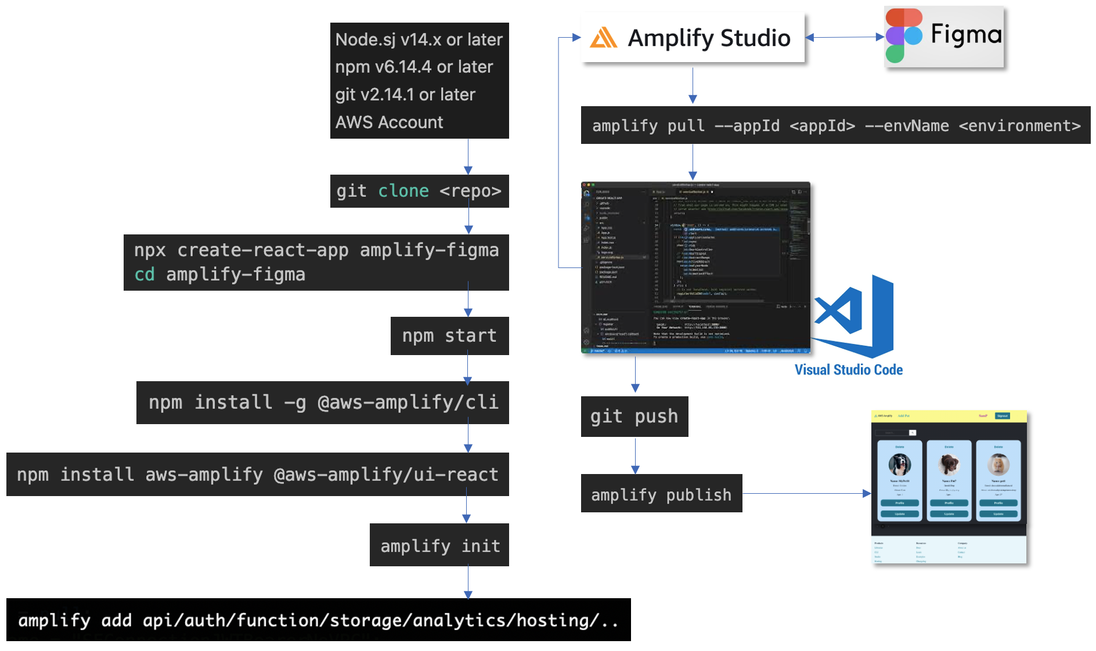
Full stack app PROCESS

Slide 6

WHAT IS FIGMA DESIGN
Interactive GUI design, prototypes, websites, mobile apps.
Layouts, colors, typography, etc.
For designers, developers, product owners (real-time feedback).
Online, cloud-based collaboration.
Vector-based design tool.
Designs to developers by providing CSS, asset exports.
Community ecosystem of plugins (AWS Amplify).
Keeps design and code connected.
Other tools: Adobe XD, InVision Studio, Sketch, Framer

Slide 7
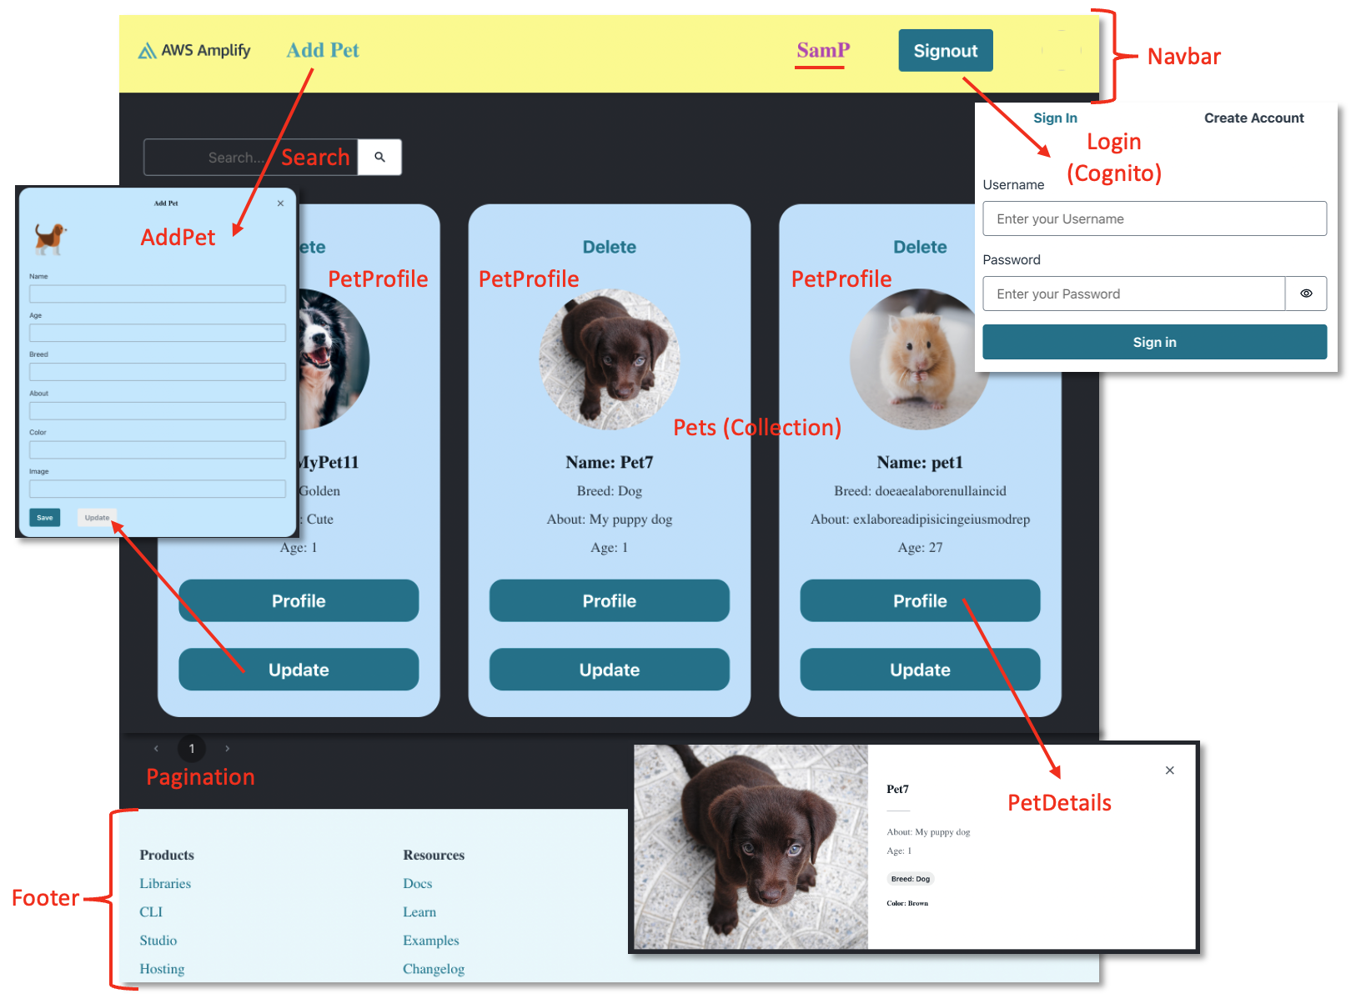
Example app

Slide 8
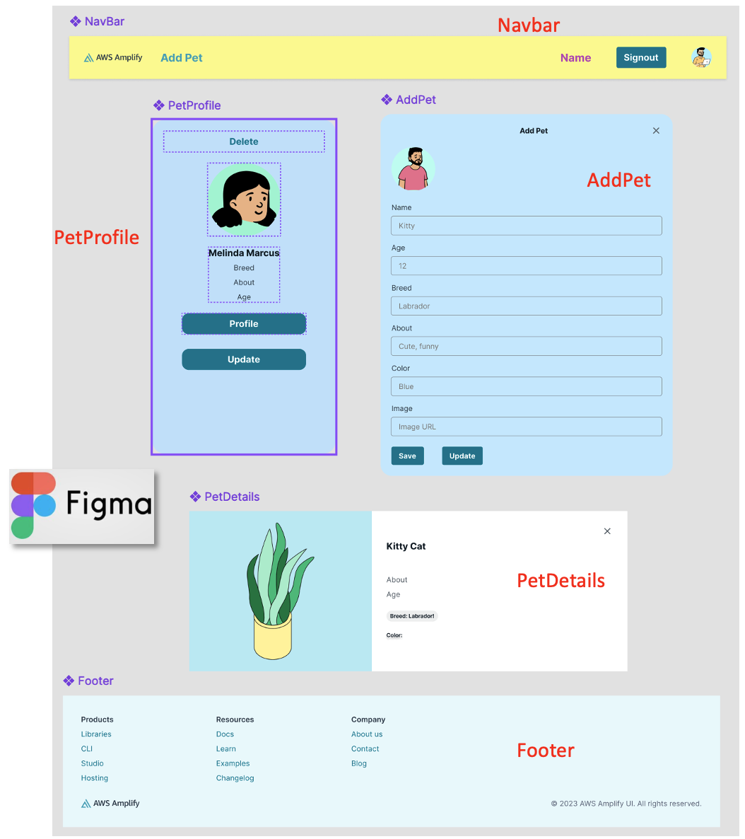
Amplify components in figma

Slide 9
Demo

Slide 10
Thank you

